Slide 1
MCTS (Checkers) AI Discussion Disclaimer : We discuss a few ideas, there are many others… We will not go into detailed technical solutions (actual code) …
Kalev Kask
Some pictures from publications referenced

Slide 2
Resources
“A Survey of Monte Carlo Tree Search Methods”
http://ccg.doc.gold.ac.uk/ccg_old/papers/browne_tciaig12_1.pdf
many others
…..

Slide 3
Basics
Board size
M = number of rows
N = number of columns
StudentAI class
This is where your code will go …
get_move()/GetMove()
called by the system, when it is your turn to move …
Time limit
E.g. 8 min per game per player …

Slide 4
Persistent Board
There is a board (member) object (of type Board) in StudentAI class, for your convenience
You need to update it yourself
e.g. when get_move() is called, opponent’s move is passed in as input, you need to call make_move() to keep the board up to date …

Slide 5
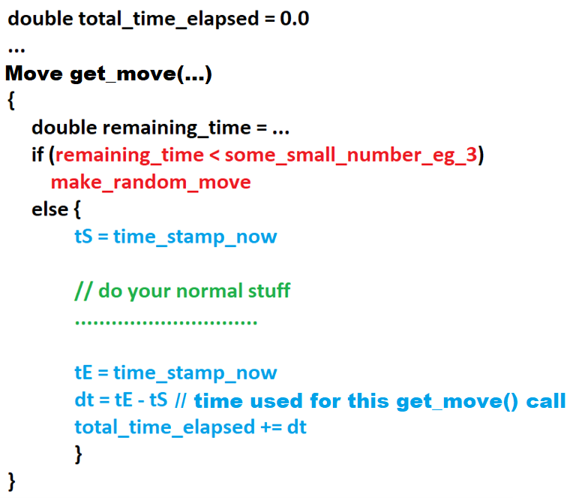
Keeping track of time
Time is of the essence
There will be a timeout
You have to keep track of time
Avg # of moves per game ? 25
8min = 480sec -> about 20 sec per move
MCTS iterations slower early, faster later

Slide 6
MCTS
Basic question :
How long does each iteration take
this determines how many iterations you can do
What to you get out of each iteration
If # iterations -> ∞ then learned win-rate -> true win-rate
The more iterations you can do, the better quality play
Are you doing enough iterations?

Slide 7
MCTS tradeoff
Make each iteration faster?
Get more out of each iteration?
Only “good quality” iterations really contribute
Naïve MCTS will execute many “poor quality” iterations -> slow convergence
Tradeoff : is the extra effort you put into each iterations (e.g. heuristic) paying off

Slide 8
MCTS how many iterations?
How many iterations is enough?
Depends of what you get out of each iteration
For checkers
100 probably not enough
1000 probably enough

Slide 9
MCTS how to make iterations faster ?
When doing selection/simulation you need the board along the way
For blind/uninformed simulation, can make a copy of “main” board in the beginning, and then just call getAllMoves()/makeMove()
If you heuristic, need to do 1-move lookahead at each state (simulation)
Do you do (deep)copy of the board, and then just makeMove() off of the (deep)copy?
Do you skip (deep)copy and do makeMove()/Undo()?

Slide 10
MCTS how to make iterations faster ?
When entering getMove()
getAllPossibleMoves() returns just 1 single move, don’t need to be MCTS
Just immediately return that 1 single move

Slide 11
MCTS how to make iterations faster ?
When simulation is taking too long?
You can cut if off, but the terminal value is unknown
Can apply heuristic
But heuristic needs to be sufficiently accurate
May need 3 states
Win
Loss
TooHardToTell

Slide 12
Heuristic
Heuristic needs to be
Accurate
Discriminative
E.g. H(s) = #B(s) - #W(s) is not discriminative
Vast majority of time, either no capture (H is same for all children) or 1-piece capture (H is same for all children)
Most of the time material value does not change
So this H is uninformative and useless for guiding MCTS

Slide 13
Heuristic : testing
Experimentally evaluate how discriminative/accurate it is
Implement simple MiniMax (a few moves lookahead) and run your H against Ramdom/Poor/Average. What is your winrate?

Slide 14
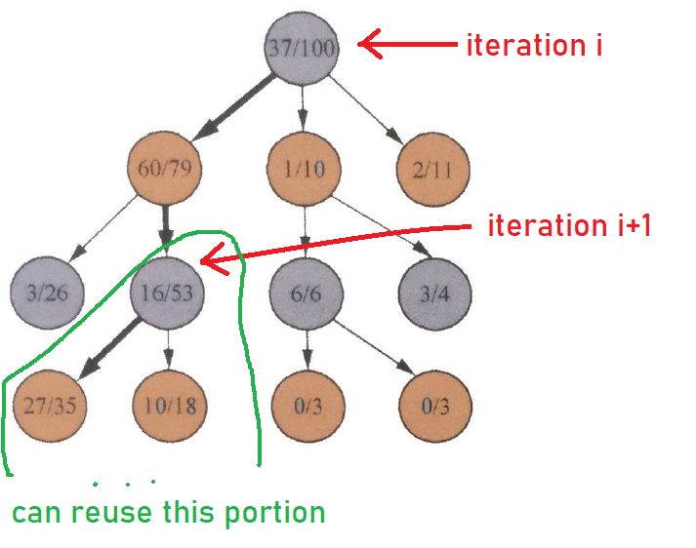
MCTS reuse subtree

Slide 15
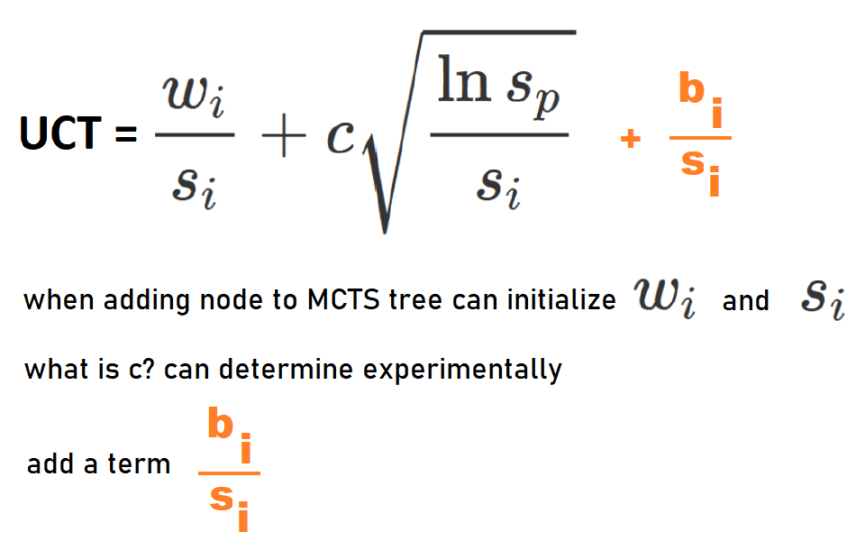
MCTS modified UCT

Slide 16
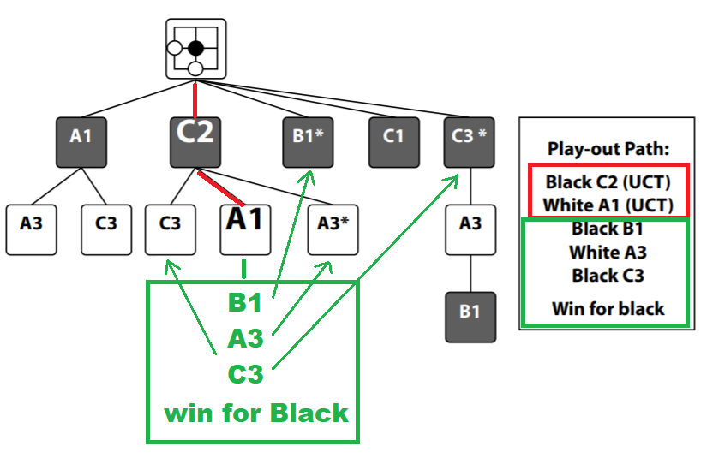
MCTS : AMAF heuristic

Slide 17
MCTS : AMAF heuristic
AMAF = All Moves As First
Value of making move a immediately is average outcome of all simulations where a is played at any time
Have a general value for each move, regardless of when it is played
Biased estimate of true move value
Based on independence assumption – value of move is unaffected by other moves before/after
Advantage = quick estimates
Disadvantage = biased

Slide 18
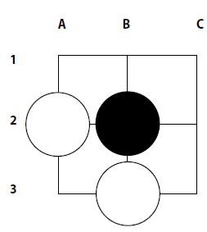
MCTS : AMAF nodes values
For nodes on the selection path,
Update those siblings of the selection path,
That correspond to moves selected during simulation
Update siblings of Start,C2,A1 based on the path Start → C2 → A1 → B1 → A3 → C3

Slide 19
MCTS : α-AMAF
Compute/keep 2 sets of counts for each node
Standard MCTS estimates
AMAF estimates
α-AMAF estimate is α∙AMAF + (1-α)∙Standard
α=0 is Standard MCTS
α=1 is (pure) AMAF
α-AMAF is blend of the two

Slide 20
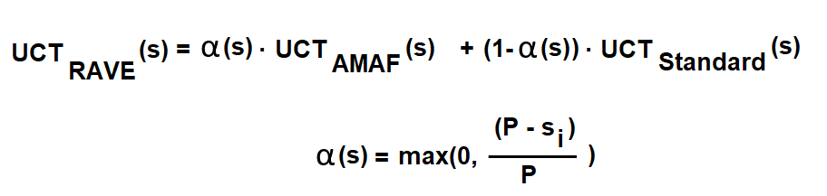
MCTS : RAVE
RAVE = Rapid Action Value Estimates
Each node in MCTS tree has its own α that starts at 1 and then decreases to 0, as more iterations go through the node
If you have very few sampled paths through the node, you rely on its AMAF estimate
If you have many sampled paths through the node, you rely on its own Standard MCTS estimate
P is a parameter, s_{i} is count for node s

